Slide 1
Behaviour-Driven Development with SpecFlow
Daley Chetwynd (@dchetwynd)
Software Developer

Slide 2
Introduction
What is Behaviour-Driven Development?
Why is BDD needed?
Gherkin feature language
SpecFlow testing with .NET
Code examples
Conclusions

Slide 3
What is Behaviour-Driven Development?
BDD used as an Agile development technique
First introduced by Dan North in 2003
Advanced on existing ideas of Test-Driven Development
Writes automated tests in human-readable syntax
First introduced as JBehave for Java
RBehave then introduced for Ruby
RSpec and Cucumber for Ruby
BDD frameworks now available for many different languages

Slide 4
Why is BDD Useful?
BDD uses an “outside-in” approach
Tests are written from an end-user viewpoint
Tests should directly match customer requirements
Tests describe expected application behaviour
Tests are understandable to non-developers

Slide 5
Gherkin Specification Language
As a customer
I want to withdraw cash from a cashpoint
So that I don’t have to queue in the bank
Scenario: Account is in credit
Given the account is in credit
And the bank card is valid
And the cashpoint contains cash
When the customer requests cash
Then ensure the account is debited
And ensure cash is dispensed
And ensure the card is returned

Slide 6
Gherkin Specification Language
As a customer
I want to withdraw cash from a cashpoint
So that I don’t have to queue in the bank
Scenario: Account is overdrawn past the overdraft limit
Given the account is overdrawn
And the card is valid
When the customer requests cash
Then ensure a rejection message is displayed
And ensure cash is not dispensed
But ensure that card is returned

Slide 7
SpecFlow
SpecFlow is a free BDD tool available from GitHub
Current SpecFlow version is 1.9
SpecFlow is a Visual Studio extension
SpecFlow uses NUnit or other test frameworks to create automated tests
Each SpecFlow feature is a test class
Each SpecFlow scenario is a test method

Slide 8
Code Examples

Slide 9
Advantages of SpecFlow
Human-readable test language
Detailed scenario descriptions can be given
Steps can be reused for similar permutations of a process
Application logic can be tested from a high-level
Tests are written from an end-user viewpoint
Only requires NUnit or other testing framework to be available

Slide 10
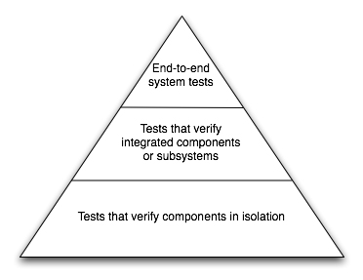
SpecFlow disadvantages
Scenario descriptions and test code need maintaining
Trust that test code implements scenario steps
Not all code bases suitable for high-level testing
SpecFlow integration tests are slower than unit tests

Slide 11
Conclusions
SpecFlow is a freely available BDD tool for .NET
Uses Gherkin to write automated tests in a human-readable format
Can be used by all business stakeholders, not just developers
Tests written from the viewpoint of end users
Use them sparingly and consider test runtime

